Slide 1
Digital Portfolio
STUDENT NAME: KALAIPRIYAN.L
REGISTER NO AND NMID: 24132011802521039/ASANM20124132011802521039
DEPARTMENT: COMPUTER SCIENCE
COLLEGE: AAGAC / ANNAMALAI UNIVERSITY

Slide 2
PROJECT TITLE
POTFOLIO DIGITAL

Slide 3


AGENDA
Problem Statement
Project Overview
End Users
Tools and Technologies
Portfolio design and Layout
Features and Functionality
Results and Screenshots
Conclusion
Github Link
3/21/2024 Annual Review

Slide 4

PROBLEM STATEMENT
To design and develop a personal portfolio website that showcases the developer's skills, projects, and contact information in a clean, responsive, and user-friendly manner using HTML, CSS, and JavaScript.

Slide 5

PROJECT OVERVIEW
This project is a simple, personal portfolio website designed and developed using HTML, CSS, and JavaScript. The main goal is to create an online platform for Kalaipriyan to showcase his personal information, technical skills, and sample projects, and to allow visitors to get in touch via a contact form.

Slide 6

WHO ARE THE END USERS?
1. Potential Employers / Recruiters
2. Clients / Freelancers / Project Collaborators
3. Academic Staff / College Evaluators

Slide 7

TOOLS AND TECHNIQUES
Technique
HTML5 (HyperText Markup Language)
CSS3 (Cascading Style Sheets)
JavaScript (Vanilla JS)
Responsive Design
Form Validation
Tool
Visual Studio Code
Web Browser (Chrome, Firefox)
GitHub (Optional)
Netlify / GitHub Pages (Optional)
Color Picker / Fonts Tool

Slide 8
POTFOLIO DESIGN AND LAYOUT
The Design of the portfolio aims to be:
Simple, clean, and easy to navigate
Responsive, so it works on both desktop and mobile
Professional, to reflect the skills and personality of Kalaipriyan
Section | Layout Description
Header | Contains the website title and navigation links. Stays at the top for easy access.
About | A short paragraph introducing Kalaipriyan, his skills, or education background.
Projects | A grid or vertical list of simple project cards showing project name + description.
Contact | A form with Name, Email, and Message input fields + "Send" button + static email.
Footer | A small section showing copyright © 2025 and your name.
8

Slide 9
FEATURES AND FUNCTIONALITY
Feature
Single Page Design
Responsive Layout
Simple Navigation Bar
About Section
Project Showcase
Contact Form
Form Validation
Confirmation Message
Facility
Lightweight Code
Fast Loading
Clean Design
Easy to Update
Free Hosting Ready
Downloadable Copy

Slide 10

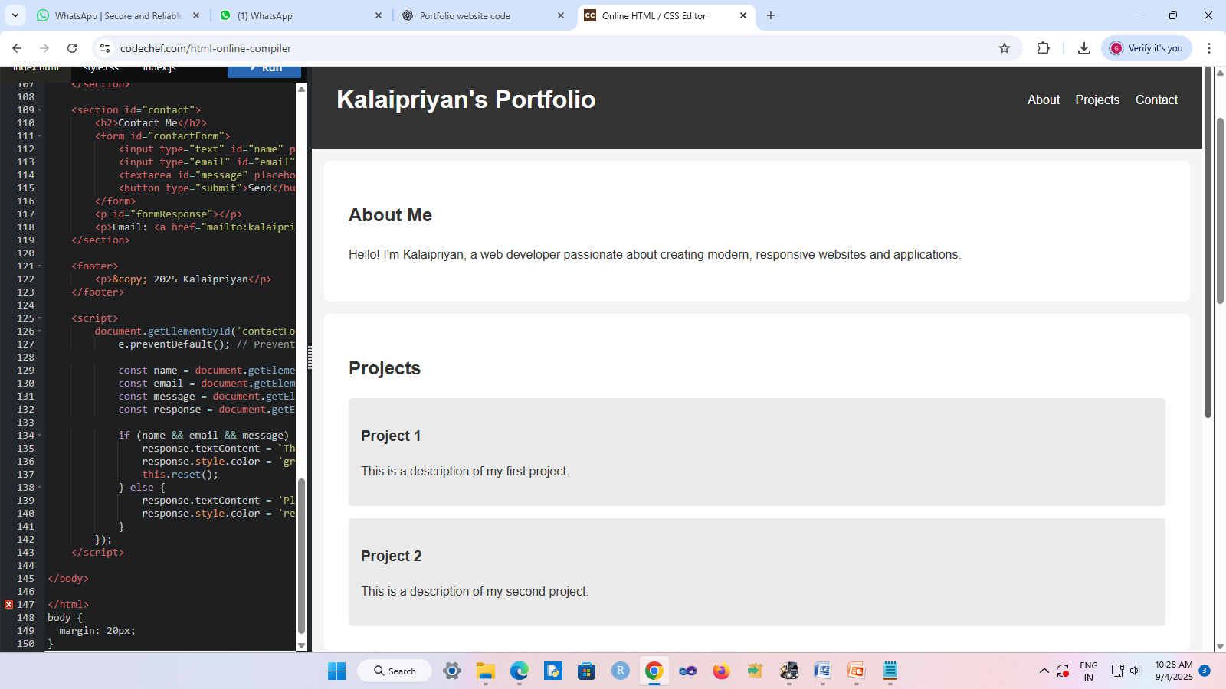
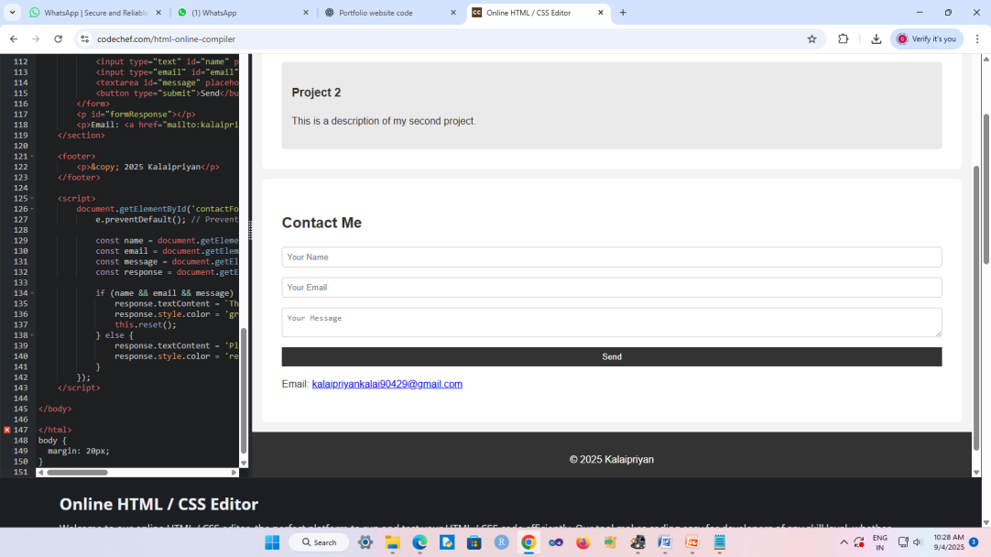
RESULTS AND SCREENSHOTS
The Portfolio Website for Kalaipriyan was successfully designed and developed using HTML, CSS, and JavaScript. The final product is a clean, responsive, and fully functional personal website that meets all the basic requirements for an entry-level developer portfolio.
3/21/2024 Annual Review
10

Slide 11
CONCLUSION
The Portfolio Website for Kalaipriyan successfully demonstrates the essential skills of web development using HTML, CSS, and JavaScript. This project highlights the ability to create a clean, responsive, and user-friendly website that effectively showcases personal information, projects, and provides a means for visitors to get in touch.
11

